Slide 1


Qassam Sarmad
20-5-2022

Slide 2

Outline
Executive Summary
Introduction
Methodology
Results
Conclusion
Appendix

Slide 3
Executive Summary
Summary of methodologies
Data Collection
Data Wrangling
Exploratory Data Analytics (EDA)
Predictive Analysis
Summary of all results
EDA Results
Geospatial results
Dashboard
Predictive Analysis

Slide 4
Introduction
SpaceX’s Falcon 9 rockets cost significantly lesser to launch primarily because SpaceX can land the first stages of the rockets and reuse them
Not all attempted landing of Falcon 9’s first stage is a success
A predictive model was made to determine if the landing of the rocket’s first stages will be successful
This can help other companies in their bids in using Falcon 9 for their launches
It will also enable Space X in identifying the gaps in their launches that result in unsuccessful landing attempts

Slide 5

Section 1

Slide 6
Executive Summary
Data collection
Using GET commands on Space X APIs
Web scraping from Wikipedia
Perform data wrangling
Using mean/average of the values to fill in missing data
Converting text data into numerical for effective prediction
Perform exploratory data analysis (EDA) using visualization and SQL
Perform interactive visual analytics using Folium and Plotly Dash
Perform predictive analysis using classification models
Using multiple models and selecting the most effective model based on its accuracy

Slide 7
Data Collection
Using Space X REST APIs
GET commands used to gather data
The responses received in .json were converted into dataframes using Pandas
Webscraping
BeautifulSoup object created from a static HTML website
The dictionary in the Soup was converted to Pandas DataFrame

Slide 8
Data Collection – SpaceX API
GET command used to get response from REST API
Response converted to .json file and then to Pandas DataFrame
Lists defined for the data to be stored
Lists used in dictionary to build the dataset
Pandas DataFrame constructed from the dictionary
DataFrame filtered to include only Falcon 9 launches
Missing values of Payload Mass replaced with the mean value pf Payload Mass
GET request for APIs
Define lists for Datasets
Datasets moved onto Pandas DataFrame
DataFrame filtered for only Falcon 9 launches
GitHub Link

Slide 9
Data Collection – Web Scraping
Static URL extracted from a HTML page
BeautifulSoup object created from the HTML response
Column headers extracted from the table located on the page
Column names were used as keys in a dictionary
Functions and logic were used to fill the dictionary values
Dictionary converted to Pandas Dataframe
Static URL
HTML Page
Beautiful Soup
Column headers
Keys
To fill Dictionary
Pandas DateFrame
GitHub Link

Slide 10
Data Wrangling
Initially the data was explored to determine:
Number of Launches
Number of occurrence for each orbit
Landing outcomes
Successful and unsuccessful landings were equated to binary values
These binary values were added onto the data frame
Missing values were also removed by adding mean values of those columns
Initial Data Exploration
Textual data converted to binary values for ease of modelling
Missing values replaced by mean values
Updated data added to the dataframe
GitHub Link

Slide 11
EDA with Data Visualization
Scatter Charts are used to visual relation between 2 numberic variables. In this project they were used to:
Orbit type and Flight numbers
Flight number and launch site
Payload and orbit type
Payload and launch site
Bar charts are useful in comparison between 2 or more categorical variables. In this project it was used to see:
Success rate and orbit type
Line graphs useful in seeing the change in the relationship between 2 numerical values over time. In this project they were used to:
Success rate and year
GitHub Link

Slide 12
EDA with SQL
SQL queries were used on the dataset to gather the following information:
Unique launch sites
Launch sites with the string ‘CCA’
Total payload mass carried by NASA’s boosters
Average payload mass carried by Falcon 9 boosters
Date of the first successful ground landing
Names of boosters successful with a payload mass between 4000 and 6000 kg
Total number of successful and unsuccessful missions
Boosters that carried the max payloads
Details of boosters which failed landing outcomes
GitHub Link

Slide 13
Interactive Geospatial Map on Folium
All launch sites marked on the map
Numbers of successful and unsuccessful launches for each site added on the map
Distance of each launch site to their proximities measured and marked
GitHub Link

Slide 14
Interactive Dashboard with Plotly Dash
Pie chart made showing the total number of successful charts per site
Scatter plot was made to show the correlation between the landing outcome and the payload mass
GitHub Link

Slide 15
Predictive Analysis (Classification)
Machine learning algorithms were first shortlisted
The data was split into training and testing sets
The object was fitted to the parameters and the model was trained for each algorithm
Confusion matrices were plotted for each model during the evaluation step
Accuracy scores were used to determine the best performing model
GitHub Link

Slide 16

Section 2

Slide 17
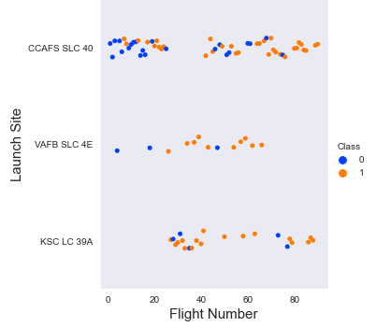
Flight Number vs. Launch Site
Earlier flights can be seen to be unsuccessful from all sites
CCAFS SLC 40 can be observed as the oldest and most used site

Slide 18
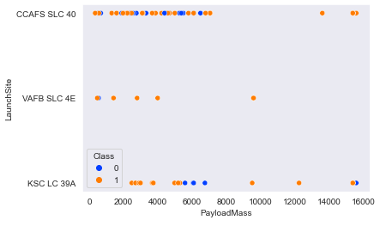
Payload vs. Launch Site
The average mass of payload seems to be somewhere around 2000 to 8000 kg
No clear correlation can be seen between these two parameters

Slide 19
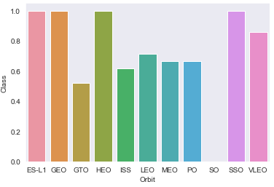
Success Rate vs. Orbit Type
ES-L1, GEO, HEO and SSO exhibit perfect success rates
SO has a 0% success rate

Slide 20
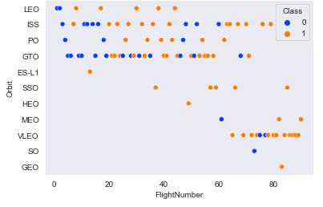
Flight Number vs. Orbit Type
This can be used to better explain the column chart discussed for Success rate vs Orbit type
GEO, HEO and ES L-1 have only 1 flight hence the 100% success rate is not as impressive
SSO has 5, 100% successful flights
Earlier flights saw lower success rates compared to later ones

Slide 21
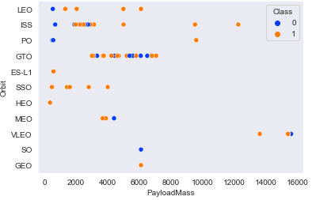
Payload vs. Orbit Type
Heavier payloads can be seen to be more successful
Overall, the relationship is very scattered and its difficult to form a correlation

Slide 22
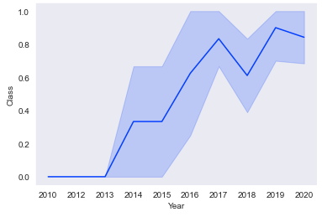
Launch Success Yearly Trend
Initial years can be seen to be very unsuccessful up till 2013
Afterwards there is a trend of general increase in the success
Sharp dip can be observed in 2018 but things seem to be back on track afterwards

Slide 23
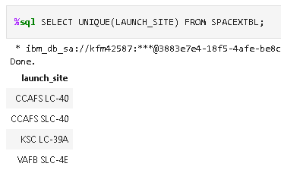
All Launch Site Names
UNIQUE command only returns the unique launch sites from the database

Slide 24
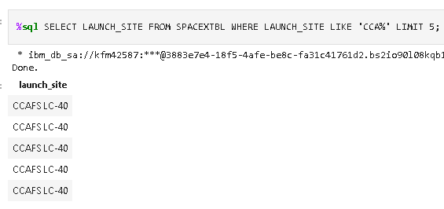
Launch Site Names Begin with 'CCA'
‘%’ is a wildcard that is used in SQL, ‘CCA%’ only gets entries starting with CCA
LIMIT is used to only fetch a certain number of entries, in this case, 5

Slide 25
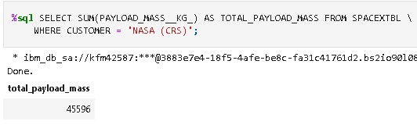
Total Payload Mass
SUM is a simple function that was used to sum the payload masses in the database

Slide 26
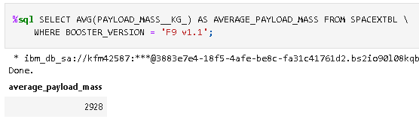
Average Payload Mass by F9 v1.1
AVG is used to calculate the average of any given column
WHERE function is used to the check the condition to see that only the entries having ‘F9 v1.1’ are used for the calculation

Slide 27
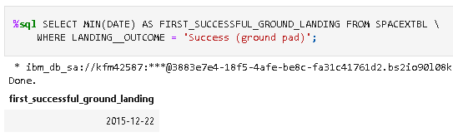
First Successful Ground Landing Date
MIN argument to used to fetch the earliest date
WHERE function is used to check the successful condtion

Slide 28
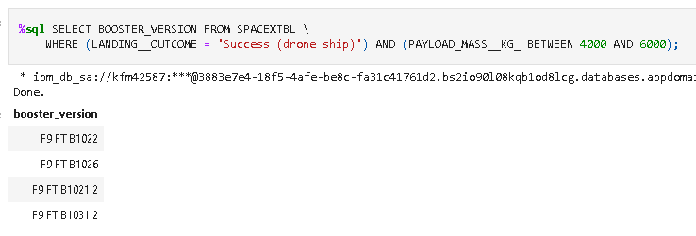
Successful Drone Ship Landing with Payload between 4000 and 6000
WHERE is used to set the condition in the argument, Success in this case
AND function is used to make sure both conditions are fulfilled
BETWEEN is used to set the range of the payload mass

Slide 29
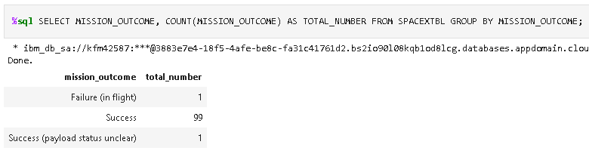
Total Number of Successful and Failure Mission Outcomes
COUNT is used to count the total number of occurrences against an argument in the database
AS is used to store the values under a new header
GROUP BY is used to arrange certain values in a separate table

Slide 30
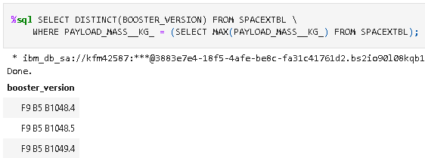
Boosters Carried Maximum Payload
DISTINCT is used so that the query does not count the same entries more than once
The second SELECT statement in the brackets show that a sub-query was used in this

Slide 31
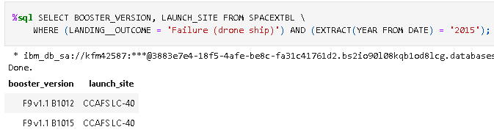
2015 Launch Records
The launch records for the year 2015 were tabulated using this query where the landing was unsuccessful

Slide 32
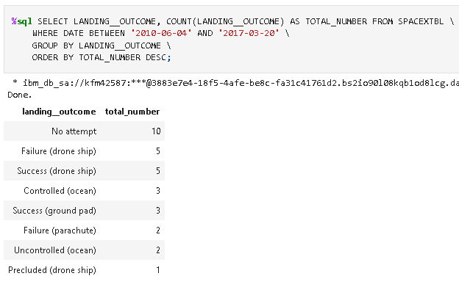
Rank Landing Outcomes Between 2010-06-04 and 2017-03-20
The query shows the landing outcomes between the given dates and presents them in a table as can be seen

Slide 33

Section 3

Slide 34

All Launch Sites
All sites are located on USA’s coast

Slide 35



Success and Failures in Launch Sites
CCAFS SLC-40

Slide 36
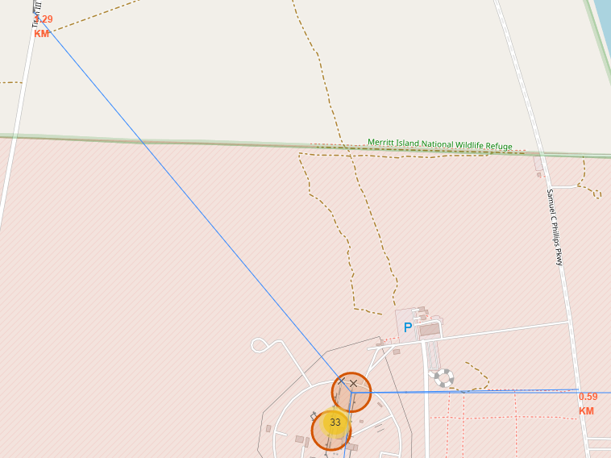
Proximity to Points of Interest
Distances marked in red
Blue lines show the direction of the launch site to point of interest

Slide 37

Section 4

Slide 38

Successful Launches for All Sites
Pie chart showing the division of successful launches between all sites

Slide 39

Launch Success Distribution for KSC LC 39-A
Distribution of launch success for the most successful site KSC LC-39A

Slide 40

Payload Mass vs Launch Outcome for All Sites
The graph shows the correlation between the mass of the payload and the outcome of the launch

Slide 41

Section 5

Slide 42
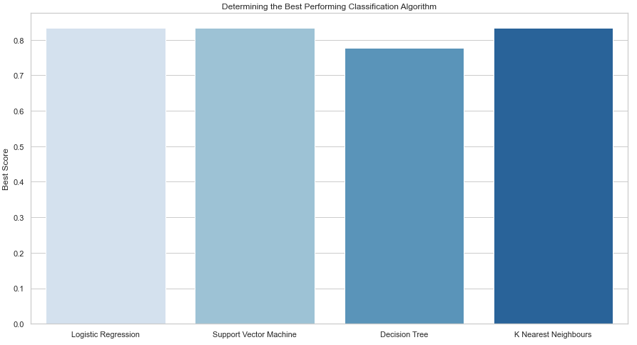
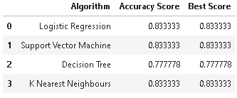
Classification Accuracy
The accuracy scores and best scores for Logistic Regression, Support Vector Machine and K Nearest Neighbors is the same
They are all feasible models for this project

Slide 43
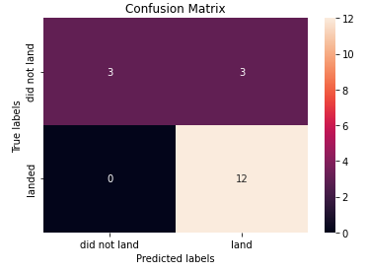
Confusion Matrix
The confusion matrix is the same for 3 best performing model
As can be seen from the matrix, only 3 values (top right) give a false positive.
Rest of the 15 results are correctly classified

Slide 44
Conclusions
With time the success rate of landings has been steadily increasing. Specially after 2013
Orbit type SSO has had 5 successful landings, making it 100% successful
Launch site KSC LC-39A is the site with the most successful launches (76.9%)
Distribution of payload is not a very good parameter to measure the success of launches
Logistic Regression, Support Vector Machine and K Nearest Neighbors are equally good models can either can be used in this case

Slide 45


